Slide 1

Module 9 – SMA-X Service Level Management
Jan 2018
Notes:
[STANDARD SLIDE: L300 (animated)]
You can change out the photo with any image from Getty Images in DropBox.
If the main title is shorter, you can make the font larger.
You may have to move the title text around depending on the photo. Make sure the text is readable against the background photo.
You can change the background color for the rectangle in the bottom-right corner to look better against the background. Choose a Micro Focus color at 25% transparency.
=========================
Note to Narrator or Reader: [PRESS] indicates press the Page Down key to show the animation
=========================
Hello and Welcome to the [COURSE_NAME] Technical Overview Training, Level 300.
In this course you’ll gain a high-level understanding of the essentials of [PRODUCT_NAME].
[PRESS] If you want to download this presentation and save it on your own system, click the Tools & Help icon in the bottom-right corner of your window and select Download.
Or, if you want to access the PPT slides and speaker notes for future reference, go to the Attachments tab in your window click to download the presentation.

Slide 2
Objectives
After completing this module, you should be able to:
Understand how Service Level Agreements are used
Prioritize work queues via Next SLT Expiration
Be able to describe the different types of SLTs
Describe the process for creating new SLTs

Slide 3
Overview

Slide 4
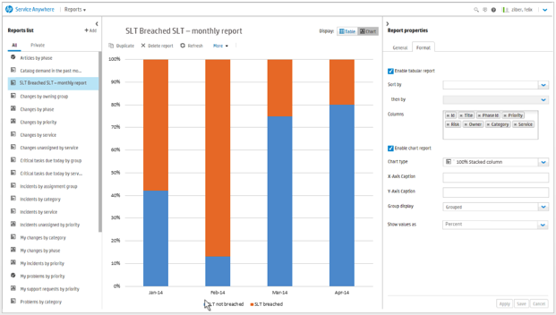
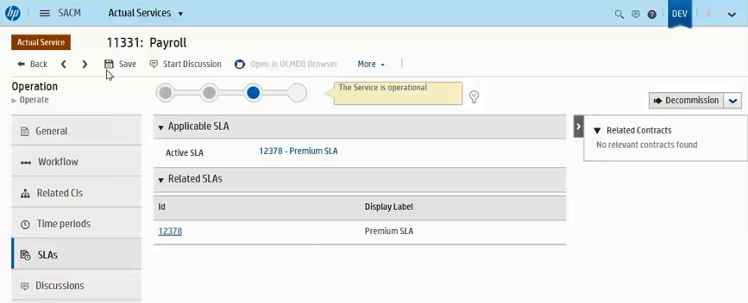
Service Level Management Overview
Goals, Benefits, and Instant Metrics
SLAs, OLAs (UCs), SLTs for Incidents and Requests
Work Queue Prioritization by next Service Level Target field for filtering and sorting lists
Hierarchical Escalation Notifications based on next target
50% – Assigned Person
75% - Assigned Person and Group
90% - Assigned Person, Group, and Group Manager
SLT Achievement Reporting
Achievement rate reports for each module and target type
Elapsed Time and Target Time for each SLT type
Breach/Achievement breakdown
Achievement trends and average duration by service, group. Aggregated SLT status on Incident/Request
Notes:
Use the reporting capabilities included in Service Anywhere to measure and track how well your organization is meeting its Service Level Targets. Use one of the 27 reports included with the system or configure your own report. You can now report on SLT achievement trends and average duration by Service, Group, Priority, and Impact. You can also report on the aggregated SLT status for Incidents and Support Requests.

Slide 5
Service Level Management Overview
Operational Level Agreements (OLA) and Underpinning Contracts (UC)
Benefits
Provide the ability to track team performance on Incidents and Requests
Allow each team to be assessed separately from other teams
Allow the expected duration to be set for teams to complete their work
Allow monitoring and alerting based on the target duration for the currently assigned team
Agreement type of ‘OLA’
Use OLA with external group for an Underpinning Contract
Targets for OLAs
'Time in Group' target type
Each Functional Group can have a different target set
Targets per Priority

Slide 6
Service Level Management Overview
Actual Service
Service Offering
Support Agreement
SLA | OLA
Service Agreement
SLA | OLA
SLT Support Requests
SLT Incidents
SLT Service
Requests
SLT
SR/I OLA
SLT
SR OLA
Service Level
Target
Initial Support | Reso-lution
P1
P2
P3
P4
Time in Group
P1
P2
P3
P4
Approval | Fulfill-ment
P1
P2
P3
P4
Time in Group
P1
P2
P3
P4

Slide 7

Dynamic SLA selection
Default behavior: SLA selected based on the Actual Service (Support Request or Incident) or Service Offering (Service Request)
Sample use case: Customer would like to select an SLA based on the organization of the related contact instead of by Service.
Feature: Define business rules that select SLA for a Support Request or Incident based on dynamic conditions
If the workflows sets the SLA then the automatic SLA selection process is bypassed and the assigned SLA is used.
Notes:
The ability to select the SLA to apply using business rules worked so well for Service Requests, that we have chosen to extend this capability to Support Requests and Incidents. You will no longer be limited to the default behavior of the SLA being selected based on the Actual Service. If the workflows sets the SLA then the automatic SLA selection process is bypassed and the assigned SLA is used.

Slide 8
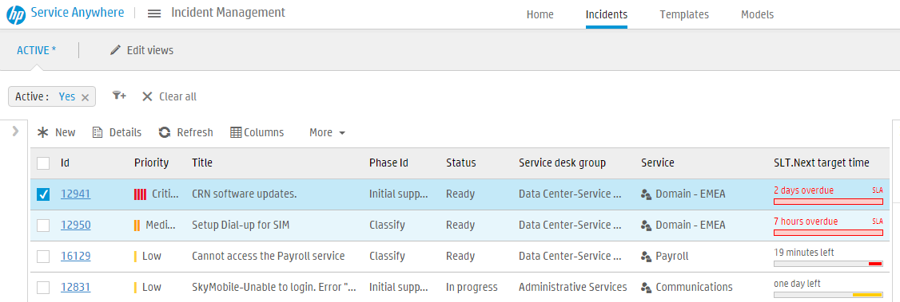
Agents organize work by SLT next target time
Notes:
In the agent portal – and specifically in the incident module.
On the list of Incidents we can display the next target date, from either the SLTs or OLTs –
And Service Anywhere displays the target that has the earliest target date whichever type
This provides agents a quick view of the nearest target, allowing them to prioritize their work taking into account both the SLA and the OLA that apply
Notice in the red circle that as you mouse over an SLT it shows whether it is an SLT or an OLT

Slide 9
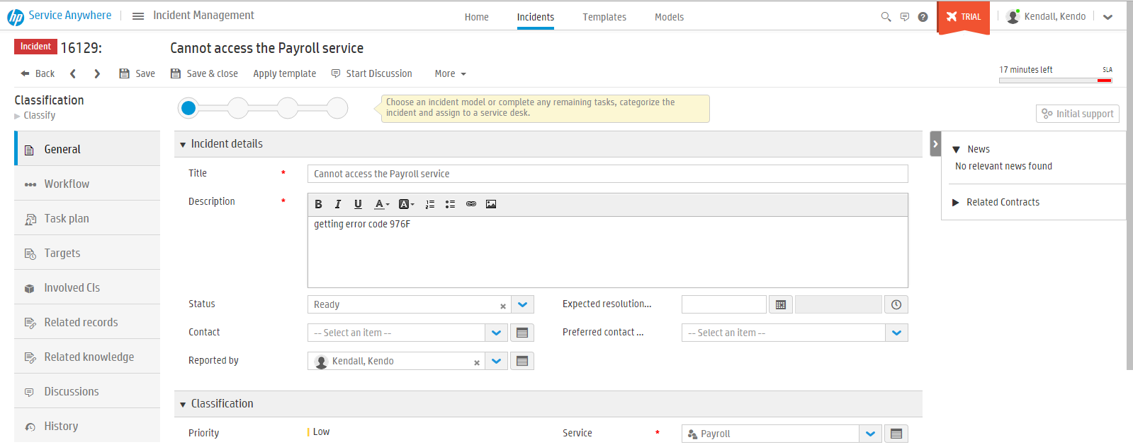
Target time in Record detail for agent
Real time update of target time
Notes:
If we drill into a particular record
Highlighted in the red circle we see the next target and it shows whether it is an SLT or an OLT
NOTE: - in the Blue box we can change the status from Ready to Suspended – and at that point all target measurements will be put on hold status can also be In Progress, Pending and completed just by the by

Slide 10
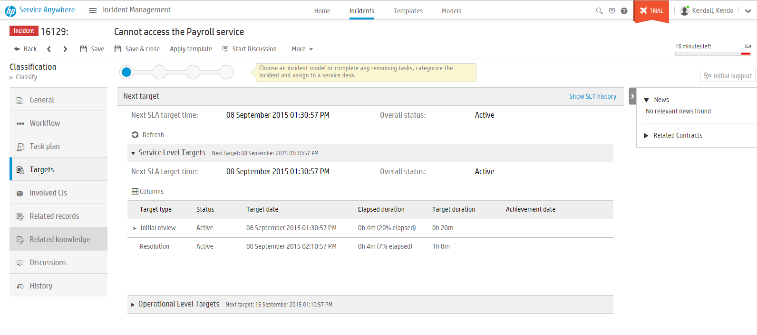
Incident detail – Targets tab
Shows ALL targets for this record
Notes:
In that same record if we click on the Target tab we see ALL targets for that record

Slide 11
Service Level Target

Slide 12
Service Level Targets by type
Target type | Description | Available for
Initial review | Defines how much time can elapse before the Service Desk categorizes and assigns a new incident or support request to an individual or a group. | Incidents and Support requests (SLA)
Resolution | Describes how long the Service Desk has to resolve the incident or support request. | Incidents and Support requests (SLA)
Chat request | Defines how much time can elapse from the time a chat request is initiated until an agent responds to the request. This target type is relevant for request records only. | Support requests and Service requests (SLA)
Approval | Defines how long it takes for the request to be approved. | Service requests (SLA)
Fulfillment | Defines how long it takes for the request to be fulfilled. | Service requests (SLA)
Time in Group | Defines how long the incident or request can be in the Assignment group. | Incidents, Support requests, and Service requests (OLA)
Notes:
The available modules are:
Incident
Support Request
Service Request
Incident/Support request OLA
Service request OLA

Slide 13
Service Level Target Duration
Target type | Record type | Duration measurement
 |  | Start | End
Initial Review | HR Support Request IT Support Request | Creation of the request | Request enters the Fulfillment metaphase
Initial Review | Incident | Creation of the incident | Incident enters the Resolution metaphase
Resolution | HR Support Request IT Support Request | Creation of the request | Request enters the Validation metaphase
Resolution | Incident | Creation of the incident | Incident enters the Validation metaphase
Chat request | HR Support Request IT Service Request IT Support Request | Creation of the chat request | Agent replies, or the user aborts the chat request
Approval | IT Service Request | Enter Approval metaphase | Exit Approval metaphase
Fulfillment | HR Support Request IT Service Request | Enter Fulfillment metaphase | Exit Fulfillment metaphase
Time in Group | Incident | Incident is assigned to the group | Incident stops being assigned to the group
Time in Group | HR Support Request IT Service Request IT Support Request | Request is assigned to the group | Request stops being assigned to the group

Slide 14
Service Level Targets by Record type
Module | Service Level Target definitions
Incident | Four initial review Service Level Target definitions (one for each possible priority). Four resolution Service Level Target definitions (one for each possible priority).
Support request | Four initial review Service Level Target definitions (one for each possible priority). Four resolution Service Level Target definitions (one for each possible priority). Four chat request Service Level Target definitions (one for each possible priority). The chat request target definitions are created only if the Chat enabled check box is selected for the target set.
Service Request | One approval Service Level Target definition (one target for all four priorities). One fulfillment Service Level Target definition (one target for all four priorities).
Incident/Support request OLA | One Time in group Service Level Target definition (one target for all four priorities) or can switch to one target for each priority
Service request OLA | One Time in group Service Level Target definition (one target for all four priorities).
Definition, Types, and Calculations

Slide 15
Support Agreements

Slide 16
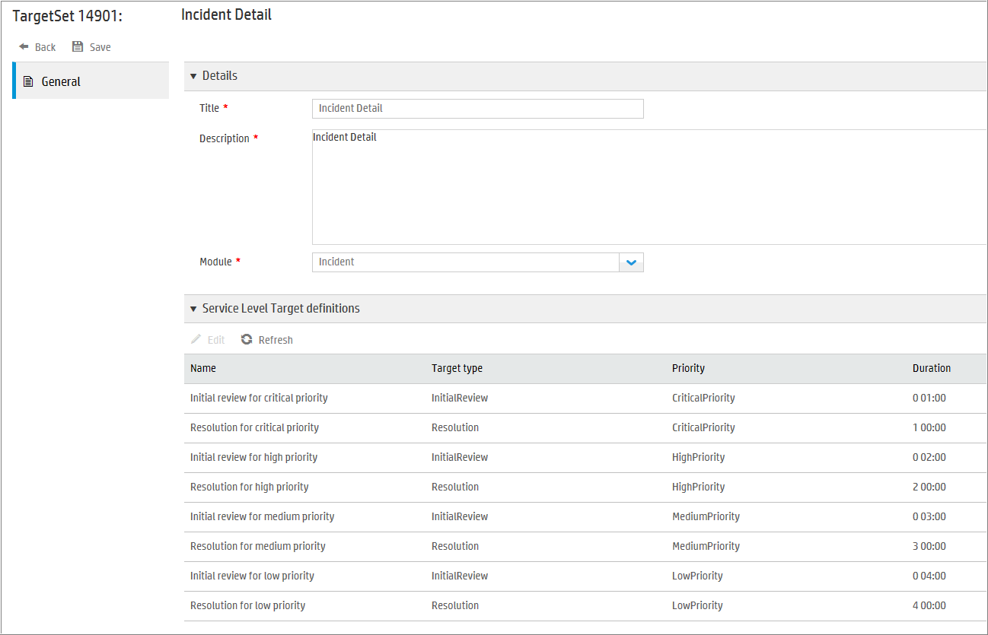
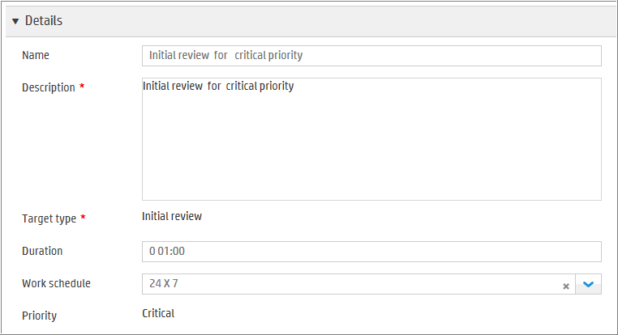
Support Agreements
Service Level Targets
For Support Requests and Incidents
Response Target Types
Initial Review - When the Incident or Request will be reviewed and acknowledged by IT
Resolution - When the Incident or Request will be resolved
Chat request response – Requests only
SLT Calculations
Duration from the time the Start SLT rule runs
Notes:
There are three types of Service Level Targets for Support Agreements:
An Initial review target defines how much time can elapse before the Service Desk categorizes and assigns a new incident to an individual or a group.
A Resolution target describes how long the Service Desk has to resolve the incident.
A Chat request target defines how much time can elapse from the time a chat request is initiated until an agent responds to the request. This target type is relevant for request records only and is used for both Support and Service request types.

Slide 17
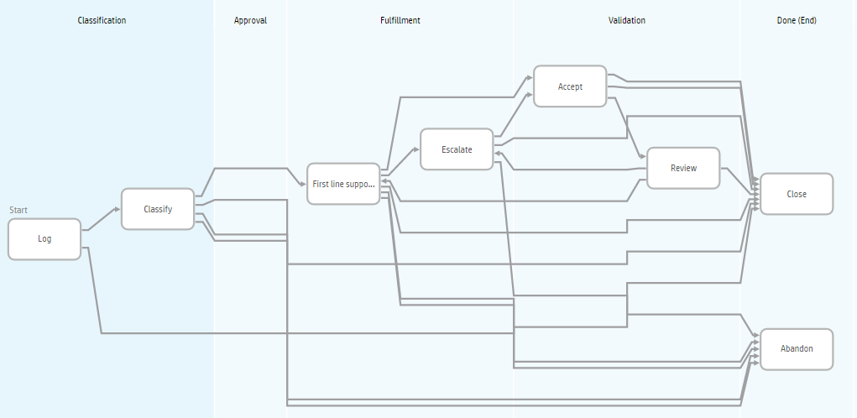
Service Level Target Workflow – Support Requests
Initial Review – Classification meta phase
Resolution – Classification through Fulfillment meta phases

Slide 18
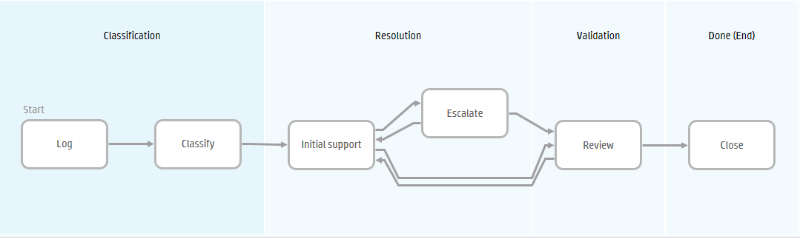
Service Level Target Workflow - Incidents
Initial Review – Classification meta phase
Resolution – Classification through Resolution meta phases

Slide 19
Service Level Management Structure
Can be based upon a Service
Service Level Agreement
Service Level Target Sets
Service Level Targets
Priority
Premium SLA
Premium SLTs for Requests
Premium SLTs for Incidents
Initial Review
Resolution
Chat Response (Request)
Priority 1
Priority 2
Priority 3
Priority 4
Based on a Priority
Notes:
A Service Level Agreement contains Service Level Target Sets for both Requests and Incidents. An example SLA is the Premium SLA for the Payroll service.
A Service Level Target Set is a set of Service Level Targets for either Requests or Incidents.
For Requests, the target types can be:
Initial Review
Resolution
Chat Request Response
For Incidents, the target types can be:
Initial Review
Resolution
There is a Service Level Target for each type of target (eg. Initial Review) for each Priority of record. For instance, in a Request the SLT duration for Initial Review may be 30 minutes for a Priority 1 request, 2 hours for a Priority 2 request, 3 hours for a Priority 3 and 6 hours for Priority 4.

Slide 20
Process for creating a Support Agreement
Create Holiday & Work Schedule
Create SLT sets
Update Target Definition
Create a SLA
Test your Work
Create Holiday
Create Work schedule to set times to measure service level performance
Add holiday to work schedule
Automatically builds 12 Target definitions
Edit or create definition
Set Duration
Active
Select Service(s)
Assign Service Level Target (Support Request and/or Incident)
Create Support Request or Incident
Select a Service

Slide 21
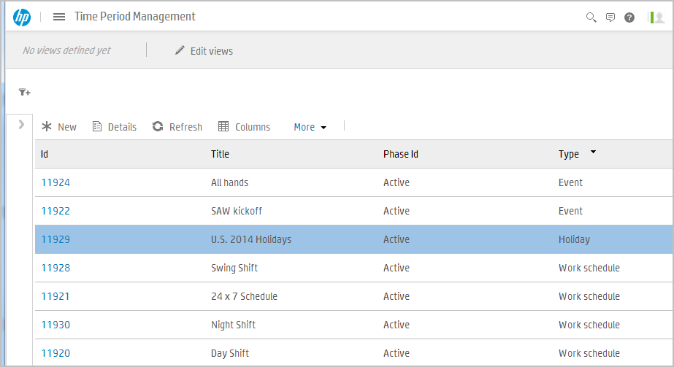
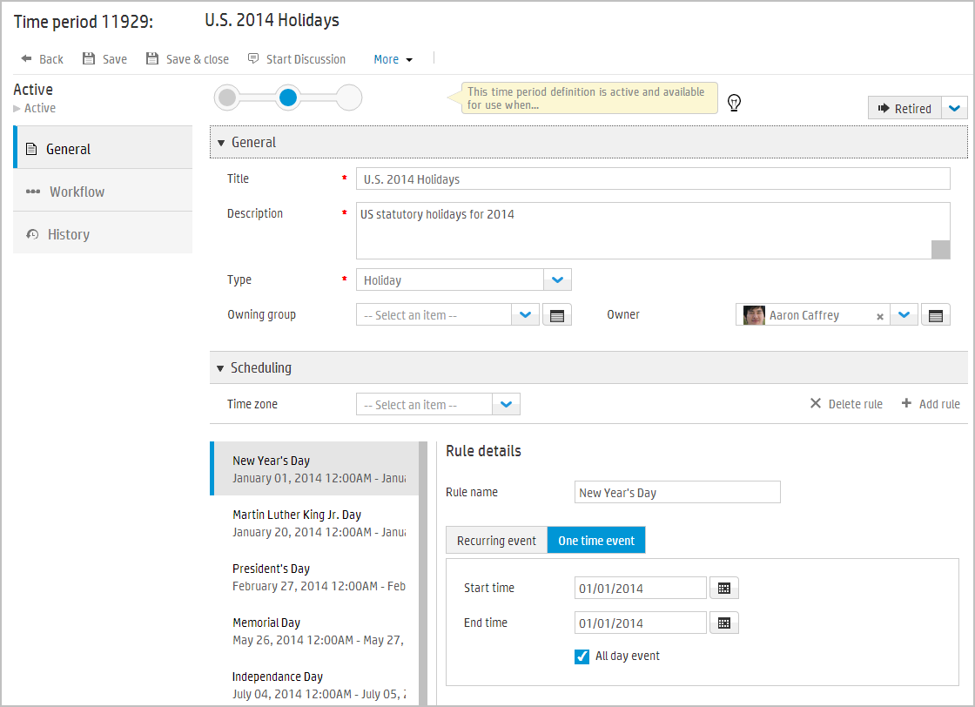
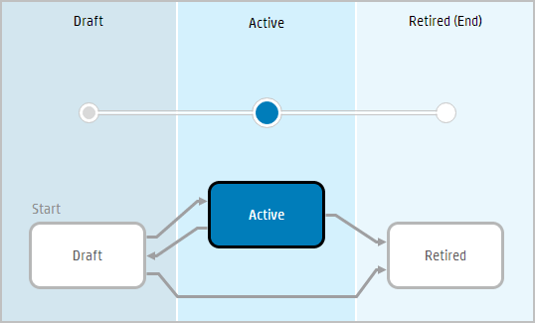
Time Period Management
Create Holiday & Work Schedule
Mega Menu > Plan > Time Period
Event Types
Maintenance
Blackout
Holiday
Event
Work Schedule (SLM)
Recurring/One time events
Select Holiday schedule
Notes:
Time Period Management
Service Anywhere's Time Period Management module enables users with the appropriate permissions to create, edit, and manage time periods for use in Change and Service Level Management. You can create maintenance, blackout, work schedule, holiday, and event time periods. Time management helps users plan implementation of changes, so as to minimize disruption, and maximize the efficient use of resources. Service Anywhere uses work schedule time periods in Service Level Management calculations.

Slide 22
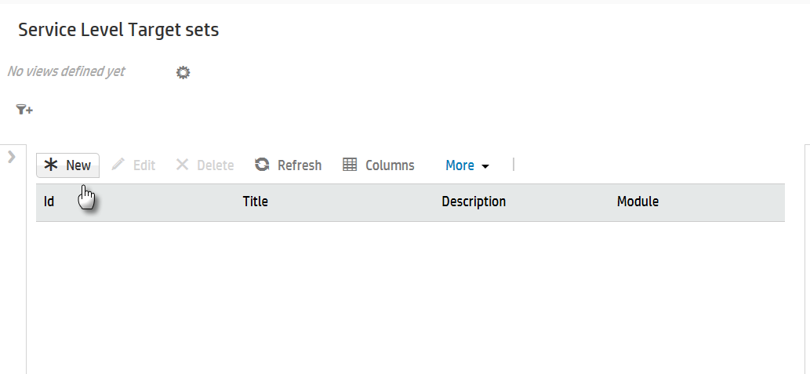
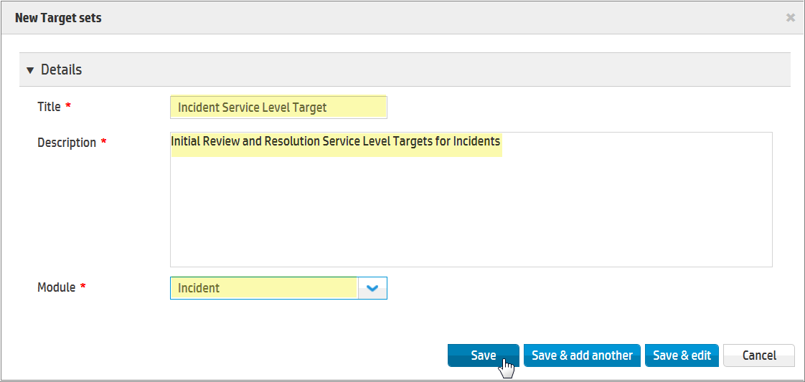
Create Service Level Target Set
Create SLT Sets
Mega Menu > Plan > Service Level > Service Level Target Sets

Slide 23
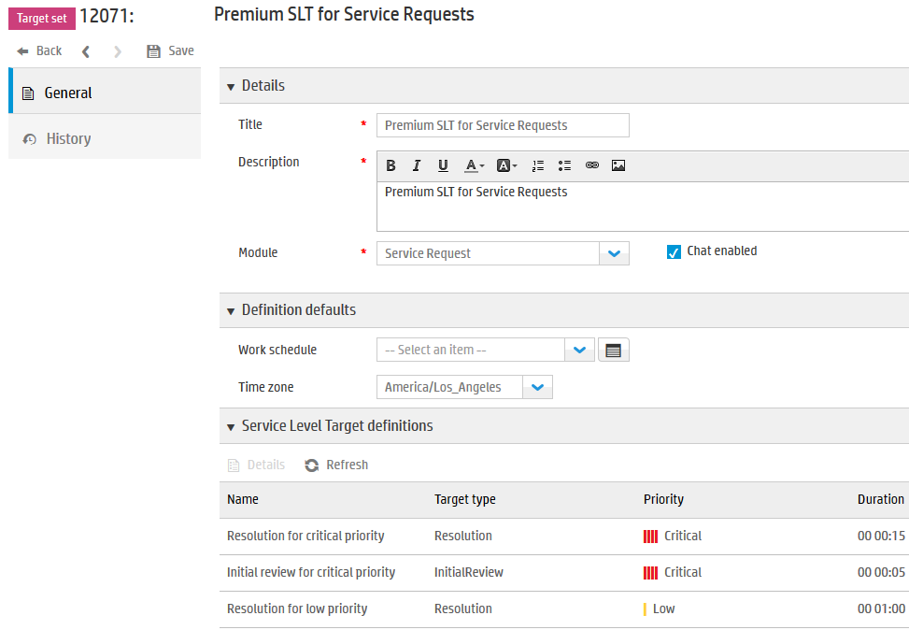
Update the Target Definition Duration times
Update Target Definition
Select the Service Level Target, then Edit the Definition to set duration
If you wish to have SLTs for Chat Response, check this box
A Service Level Target Set contains:
Title
Description
Module
Chat enabled (request only)
Work schedule
Time zone
Service Level Target definitions
Module is either Support Request or Incident
Can define work schedule and/or time zone for SLT Set
A Resolution and Initial review SLT will be automatically created for each Priority of request
Notes:
Service Level Target Sets
Service Anywhere automatically creates Service Level Target definitions when you create a Service Level Target set:
Four initial review Service Level Target definitions (one for each possible priority).
Four resolution Service Level Target definitions (one for each possible priority).
Four chat request Service Level Target definitions (one for each possible priority) for request records only.
Incident records have eight out-of-the-box Service Level Target definitions.
Request records have twelve out-of-the-box Service Level Target definitions.
It is not necessary to add other Service Level Target definitions manually. Edit any generated record to refine the default values and add target duration information.
Note: Any Service Level Target definition remains inactive until you add a duration value and save the record.

Slide 24
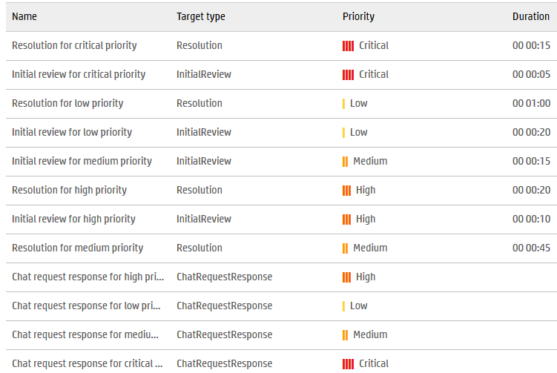
Update the Target Definition Duration times
A Resolution and Initial review SLT will be automatically created for each Priority of request
Select the Service Level Target, then Edit the Definition to set duration
A Service Level Target Set contains:
Title
Description
Module
Chat enabled (request only)
Work schedule
Time zone
Service Level Target definitions
If Chat enabled checkbox was checked, a Chat request response SLT will be automatically created for each Priority of Request
Notes:
Service Level Target Sets
Service Anywhere automatically creates Service Level Target definitions when you create a Service Level Target set:
Four initial review Service Level Target definitions (one for each possible priority).
Four resolution Service Level Target definitions (one for each possible priority).
Four chat request Service Level Target definitions (one for each possible priority) for request records only.
Incident records have eight out-of-the-box Service Level Target definitions.
Request records have twelve out-of-the-box Service Level Target definitions.
It is not necessary to add other Service Level Target definitions manually. Edit any generated record to refine the default values and add target duration information.
Note: Any Service Level Target definition remains inactive until you add a duration value and save the record.

Slide 25
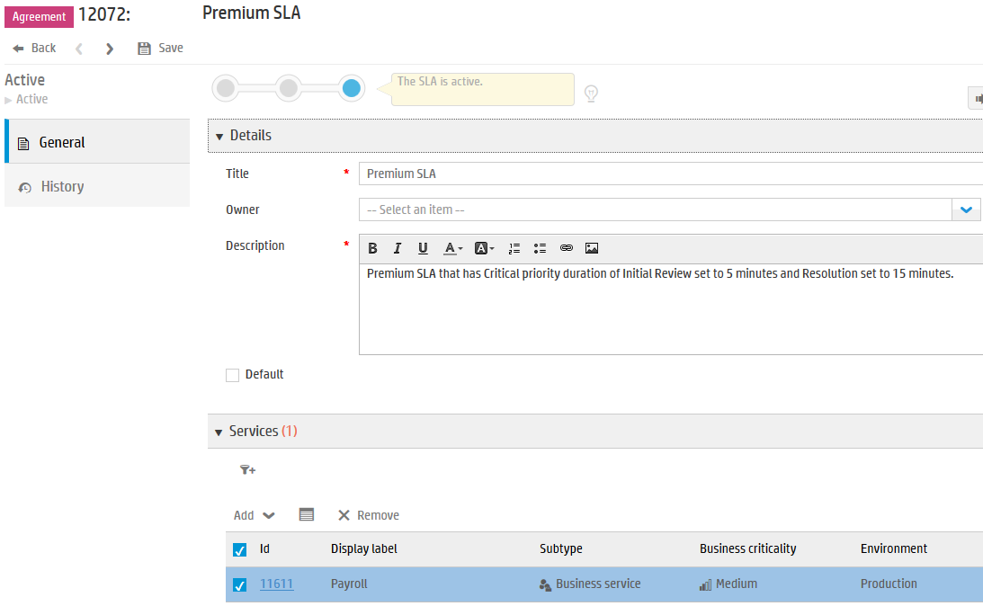
Create a Support Agreement
Create SLA
Mega Menu > Plan > Service Level > Support Agreements
A Service Level Agreement contains:
Title
Owner
Description
Default
Services
Target Sets
The default SLA if service in request or incident is not defined in an SLA
This SLA is defined for the Payroll service
Request and Incident target sets
Notes:
A Service Level Agreement is a contract between the service provider and the customer to supply services. The service targets are usually measurable goals for service hours and service availability.
The Service Level Agreement that applies to an incident depends on the organization of the affected customer and the affected service. For example, a network outage that affects internal personnel who connect through a VPN is a critical incident during normal business hours. The Service Level Agreement for that scenario could require that services are to be restored within a very small amount of time.
The Service Level Agreement for a service request can describe the fulfillment requirements and acceptable delivery time. For example, a manager requests a laptop for a new employee with the expectation that the laptop will arrive on time. There is a known lead time to obtain the laptop. An emergency service request to repair a laptop assigned to an employee has a critical priority. The impact of lost productivity escalates the resolution urgency.
A single Service Level Agreement can support more than one organization and more than one service. For example, a network outage can affect the internal VPN used by employees and portals used by customers. There is more than one affected organization and more than one service. Although you can specify more than one service in an Service Level Agreement, do not identify any service in more than one Service Level Agreement.

Slide 26
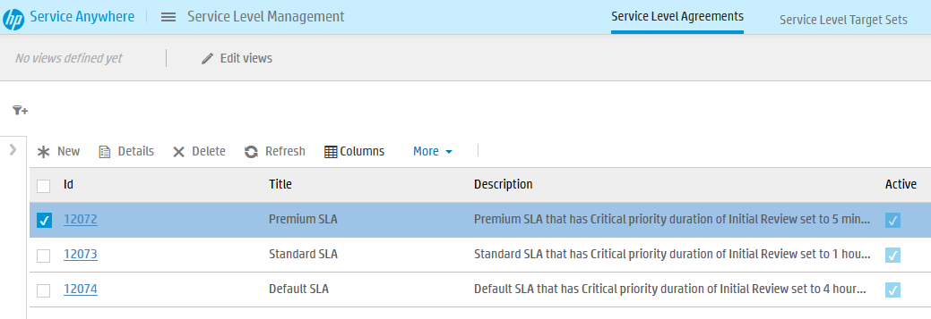
Accessing Support Agreements
Mega Menu > Plan > Service Level > Support Agreements
Sample data: Services defined in Service Level Agreements
Premium SLA: for Payroll
Standard SLA: Checkout, Catalog, Backup Data-Center
Default SLA: all other Services

Slide 27
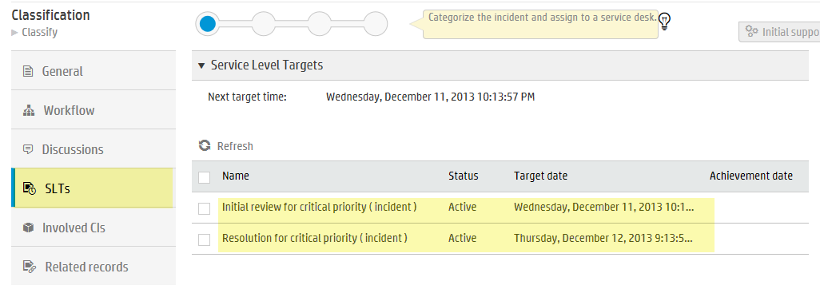
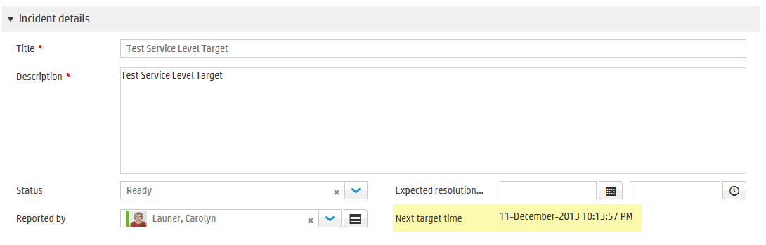
Check your work
Test your Work
Incident details or SLTs tab

Slide 28
Service Agreements

Slide 29
Service Agreements
Service Catalog Request SLTs
SLAs and OLA/UCs for Service Requests
Linked to the Service Request through the Catalog Offering
SLAs have two target types for Service Requests
Approval target
Starts when the request is submitted
Stops when the request is approved or denied (leaves the Approval metaphase)
Fulfillment target
Starts when the request is enters the fulfillment metaphase
Stops when the request leaves the fulfillment metaphase
Benefits
Provide the ability to set targets for the approval and fulfillment of Service Requests based on the catalog offering that was requested
Targets are visible to the IT agents responsible for the fulfillment of the Service Request and can assist with work prioritization
Targets trigger hierarchical escalation when necessary to ensure that targets are not breached without proper visibility
Notes:
There are 2 ways to measure service level :
The first is Approval time and the second is Fulfilment time
The same process for creating SLTs for Service Catalog requests applies here as it did for the SLTs for Supports requests and Incidents

Slide 30
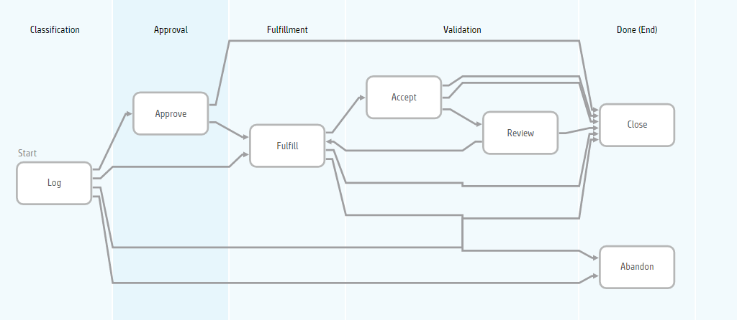
Service Level Target Workflow – Service Requests
Approval – Classification meta phase
Fulfillment– Classification through Fulfillment meta phases

Slide 31
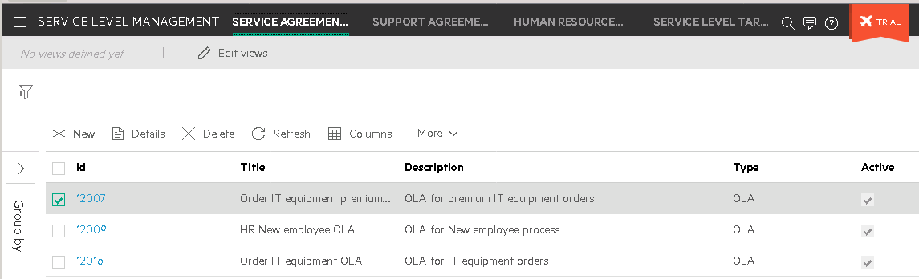
Accessing Service Agreements
Mega Menu > Plan > Service Level > Service Agreements

Slide 32
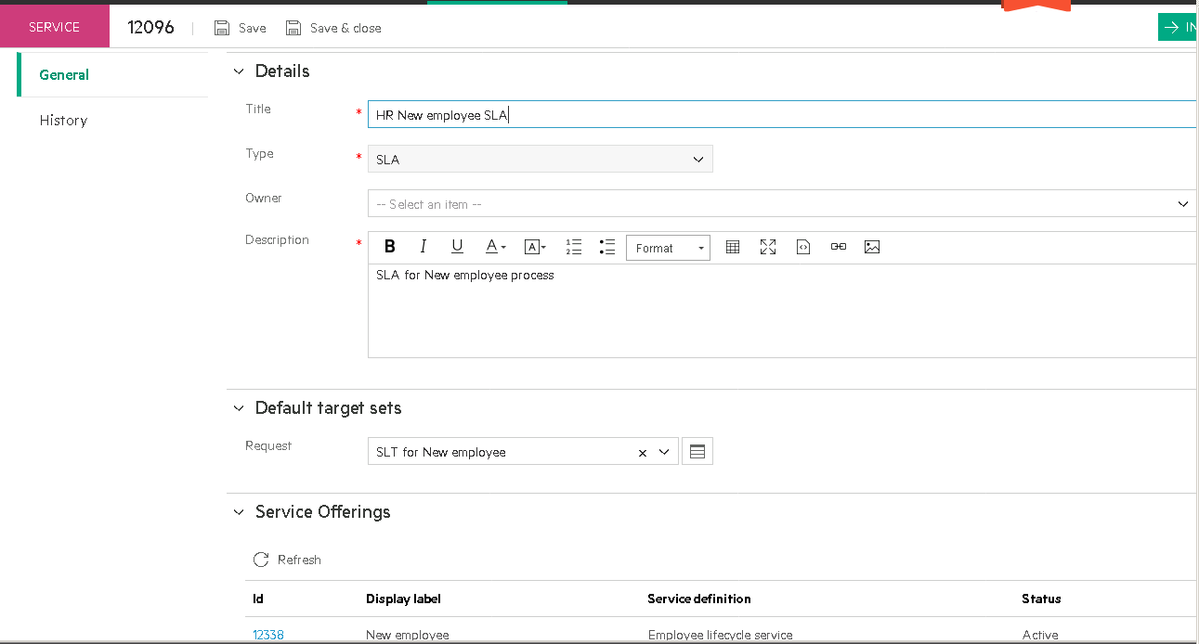
Service Level Agreements will be related to Service Catalog offerings

Slide 33
Operational Level Agreement

Slide 34
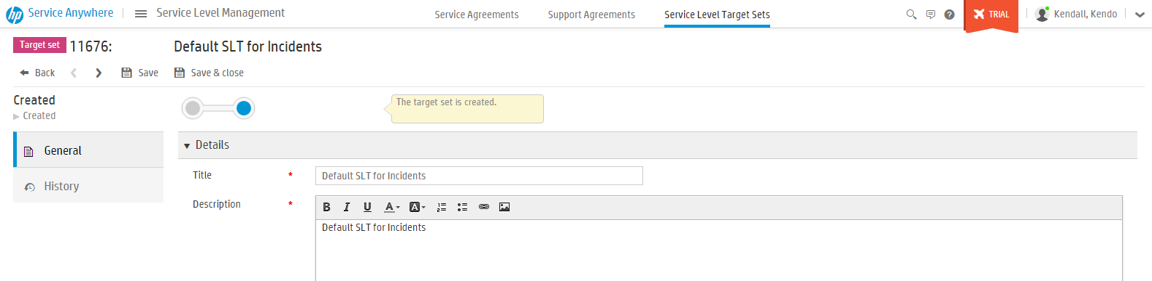
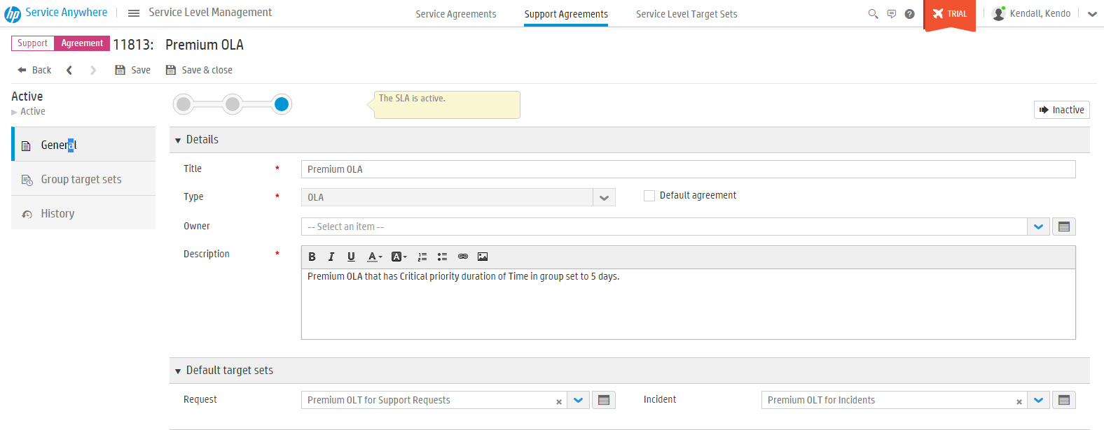
Create an Operational Level Agreement process
Mega menu -> Plan -> Service Level -> Service Level Target Sets
1 - Create Service Level Target Sets
2 - Create Agreements
And
“Attach” Default target sets
Notes:
OLAs are defined in exactly the same way that SLAs have been defined.
Define the Service level target sets first
Then create the Agreement (whether it is Service Level Agreement or Operational Level Agreement)
Then in the agreement definition add the previously defined group target sets which in the case of OLAs are Operational Level targets (OLTs)

Slide 35

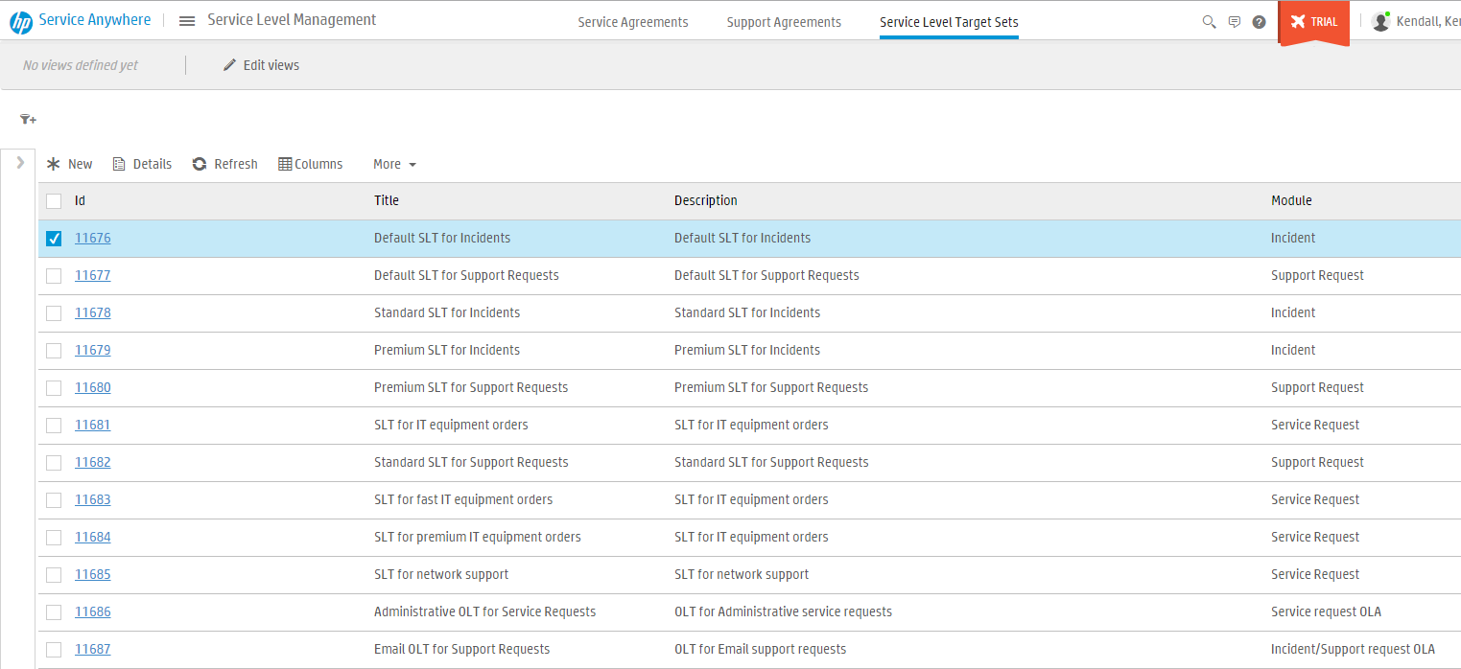
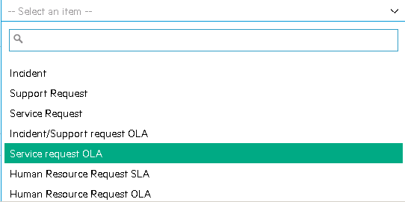

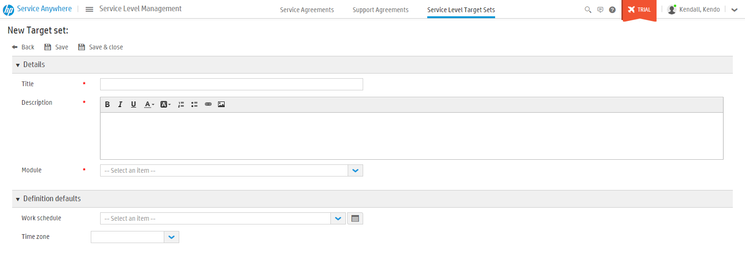
Create a new Service Level Target of type OLA (1)
Mega menu -> Plan -> Service Level -> Service Level Target Sets
Notes:
Click New
Fill in details
Select module this applies to
Select schedule & time zone

Slide 36
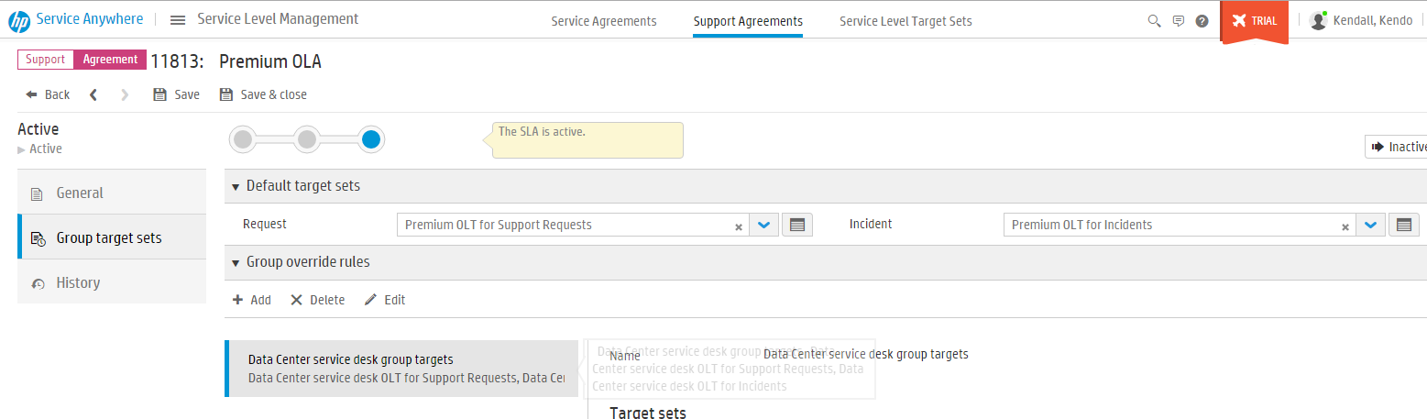
Add Group target sets (OLTs)
Mega menu -> Plan -> Service Level -> Service Level Target Sets
3 - Add Group target sets (OLTs)
Notes:
OLAs are defined in exactly the same way that SLAs have been defined.
Define the Service level target sets first
Then create the Agreement (whether it is Service Level Agreement or Operational Level Agreement)
Then in the agreement definition add the previously defined group target sets which in the case of OLAs are Operational Level targets (OLTs)

Slide 37
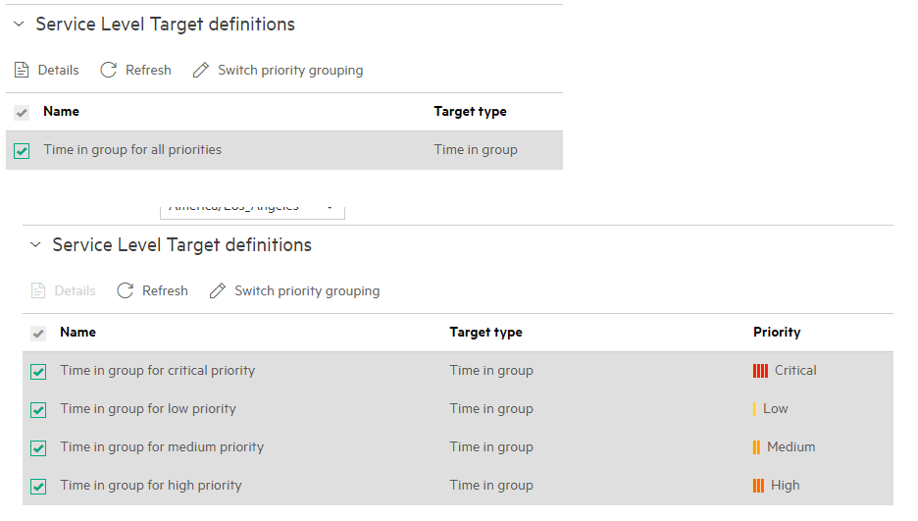
OLA Priority grouping toggle
One target for all priorities or separate targets for each priority

Slide 38
Exercise
Review the (SLT) Targets tab on the Requests and Incidents that you have created in your tenant while practicing the demo cards in previous modules
Review the Service Level Management Reports on your dashboard and in the Reports module

